Slide 1

Control Flow

Slide 2
So Far

Slide 3

CS Bridge

Slide 4
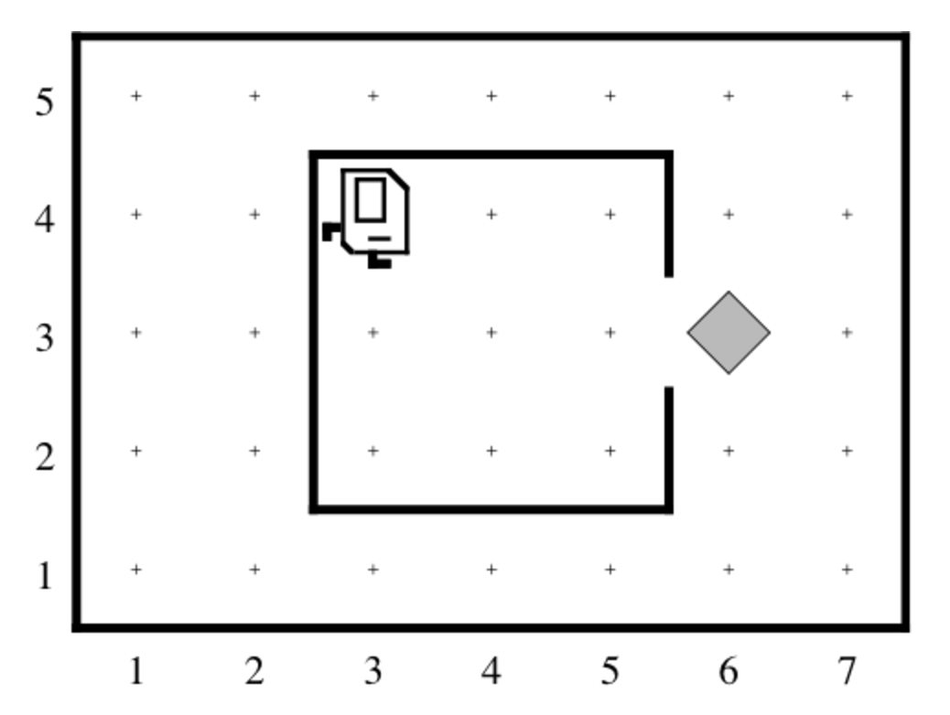
Newspaper Karel

Slide 5
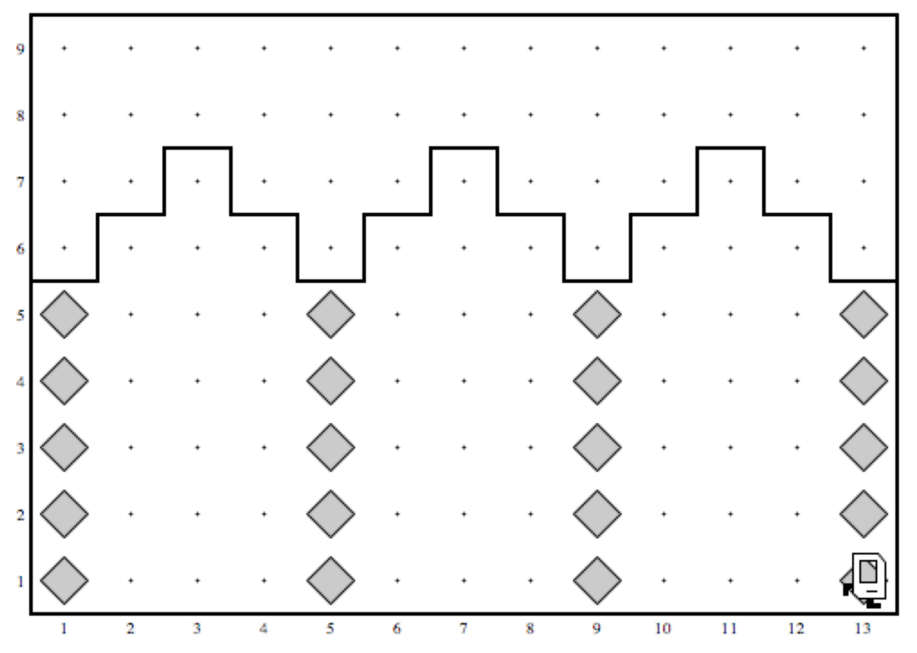
Build Efes Karel

Slide 6
Very exciting...

Slide 7
Next task

Slide 8
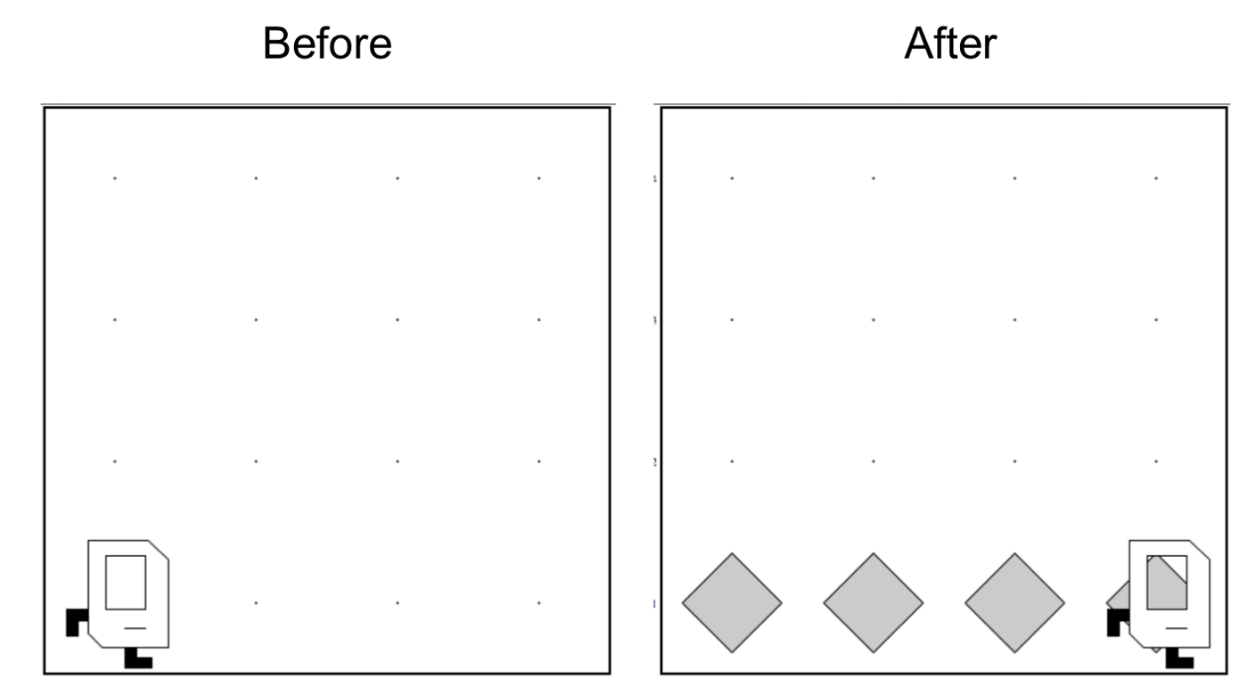
Place Beeper Line

Slide 9
Place Beeper Line
import stanford.karel.*;
public class BeeperLine extends SuperKarel {
public void run() {
for(int i = 0; i < 4; i++) {
putBeeper();
move();
}
}
}

Slide 10
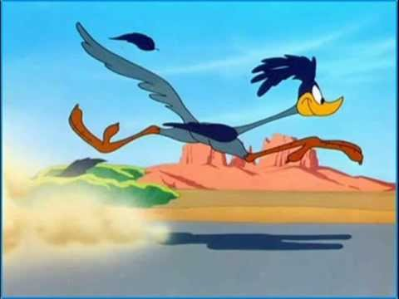

Slide 11
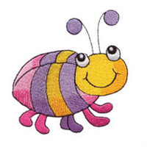
Place Beeper Line
import stanford.karel.*;
public class BeeperLine extends SuperKarel {
public void run() {
for(int i = 0; i < 4; i++) {
putBeeper();
move();
}
}
}

Slide 12
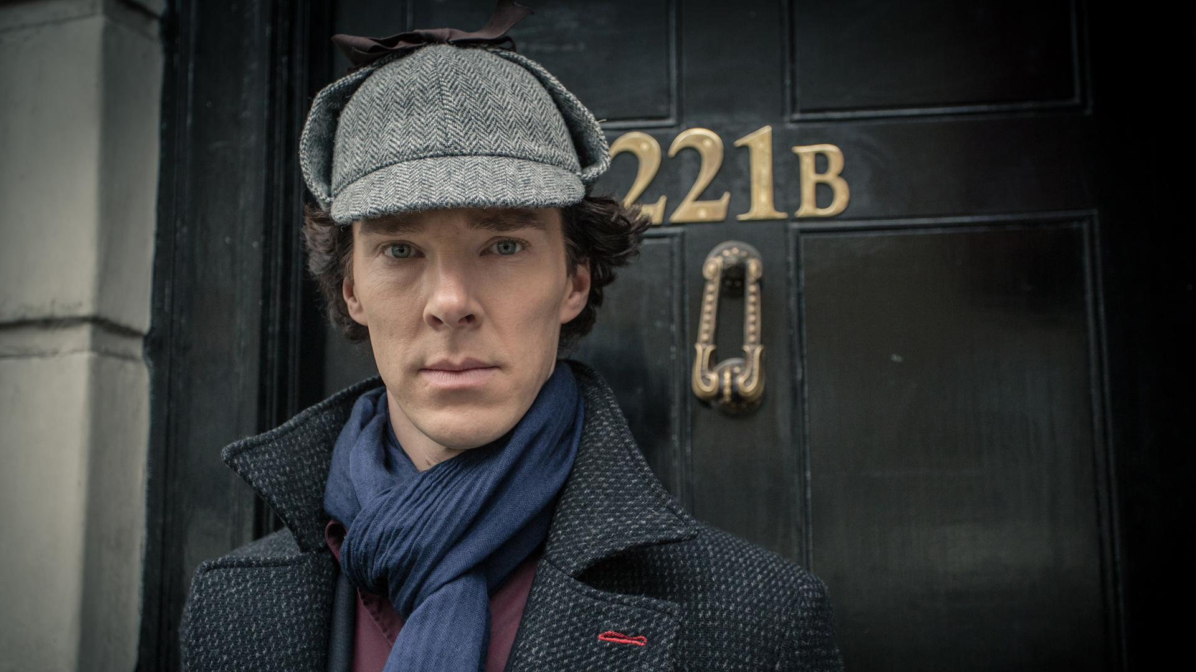

Slide 13
Place Beeper Line
import stanford.karel.*;
public class BeeperLine extends SuperKarel {
public void run() {
for(int i = 0; i < 4; i++) {
putBeeper();
move();
}
}
}

Slide 14
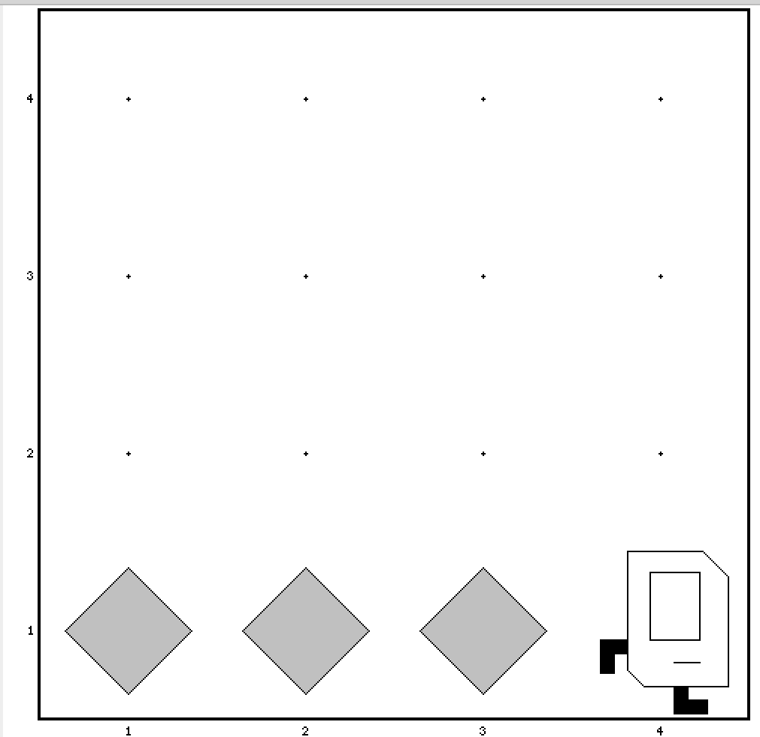
Place Beeper Line
import stanford.karel.*;
public class BeeperLine extends SuperKarel {
public void run() {
for(int i = 0; i < 3; i++) {
putBeeper();
move();
}
}
}

Slide 15

Place Beeper Line
import stanford.karel.*;
public class BeeperLine extends SuperKarel {
public void run() {
for(int i = 0; i < 3; i++) {
putBeeper();
move();
}
// extra put beeper
putBeeper();
}
}

Slide 16
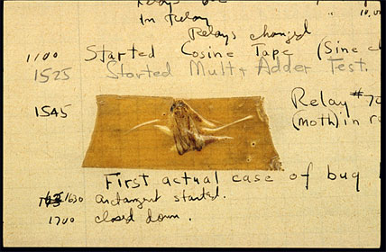
Actual Bug from Mark II Computer
Actual Bug from Marc II

Slide 17
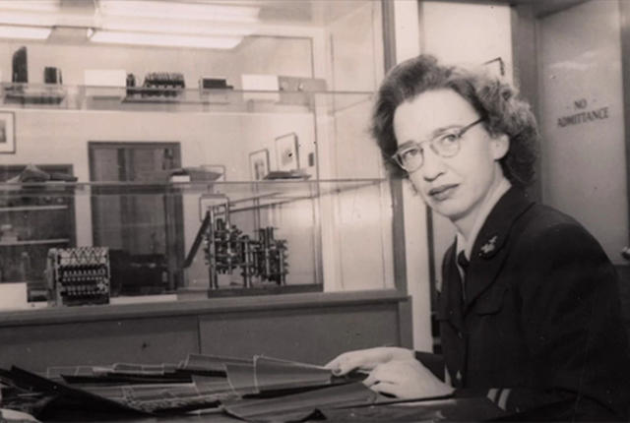
Grace Hopper

Slide 18
Don’t Know World Size
?

Slide 19
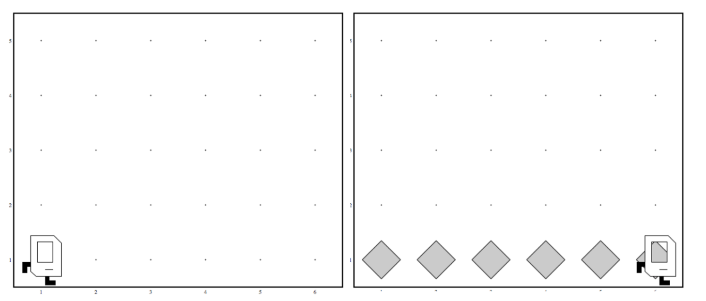
Work in Any World
Before
After
Before
After

Slide 20
While Loop

Slide 21
While Loop
import stanford.karel.*;
public class BeeperLine extends SuperKarel {
public void run() {
// example while loop
while(condition) {
code to repeat
}
}
}

Slide 22
Place Beeper Line
import stanford.karel.*;
public class BeeperLine extends SuperKarel {
public void run() {
// example while loop
while(frontIsClear()) {
move();
}
// extra put beeper
putBeeper();
}
}

Slide 23
Place Beeper Line
import stanford.karel.*;
public class BeeperLine extends SuperKarel {
public void run() {
// example while loop
while(frontIsClear()) {
putBeeper();
move();
}
// extra put beeper
putBeeper();
}
}

Slide 24
Place Beeper Line
import stanford.karel.*;
public class BeeperLine extends SuperKarel {
public void run() {
// example while loop
while(frontIsClear()) {
putBeeper();
move();
}
// extra put beeper
putBeeper();
}
}

Slide 25
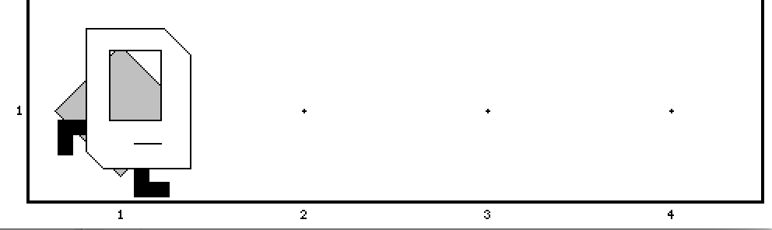
Place Beeper Line
import stanford.karel.*;
public class BeeperLine extends SuperKarel {
public void run() {
// example while loop
while(frontIsClear()) {
putBeeper();
move();
}
// extra put beeper
putBeeper();
}
}

Slide 26
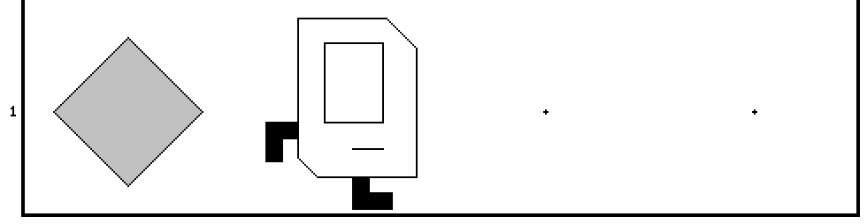
Place Beeper Line
import stanford.karel.*;
public class BeeperLine extends SuperKarel {
public void run() {
// example while loop
while(frontIsClear()) {
putBeeper();
move();
}
// extra put beeper
putBeeper();
}
}

Slide 27
Place Beeper Line
import stanford.karel.*;
public class BeeperLine extends SuperKarel {
public void run() {
// example while loop
while(frontIsClear()) {
putBeeper();
move();
}
// extra put beeper
putBeeper();
}
}

Slide 28
Place Beeper Line
import stanford.karel.*;
public class BeeperLine extends SuperKarel {
public void run() {
// example while loop
while(frontIsClear()) {
putBeeper();
move();
}
// extra put beeper
putBeeper();
}
}

Slide 29
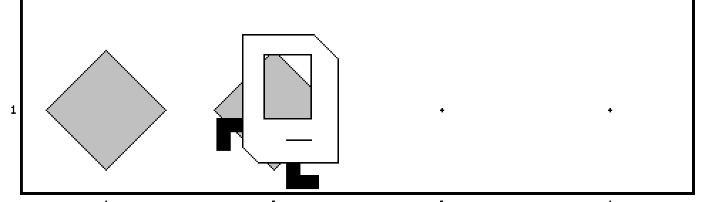
Place Beeper Line
import stanford.karel.*;
public class BeeperLine extends SuperKarel {
public void run() {
// example while loop
while(frontIsClear()) {
putBeeper();
move();
}
// extra put beeper
putBeeper();
}
}

Slide 30
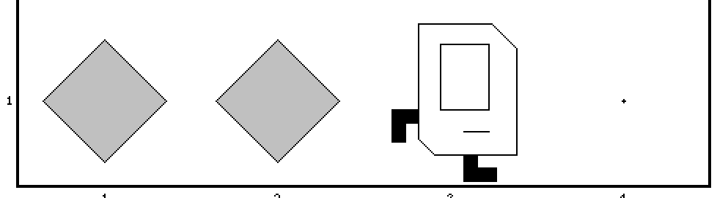
Place Beeper Line
import stanford.karel.*;
public class BeeperLine extends SuperKarel {
public void run() {
// example while loop
while(frontIsClear()) {
putBeeper();
move();
}
// extra put beeper
putBeeper();
}
}

Slide 31
Place Beeper Line
import stanford.karel.*;
public class BeeperLine extends SuperKarel {
public void run() {
// example while loop
while(frontIsClear()) {
putBeeper();
move();
}
// extra put beeper
putBeeper();
}
}

Slide 32
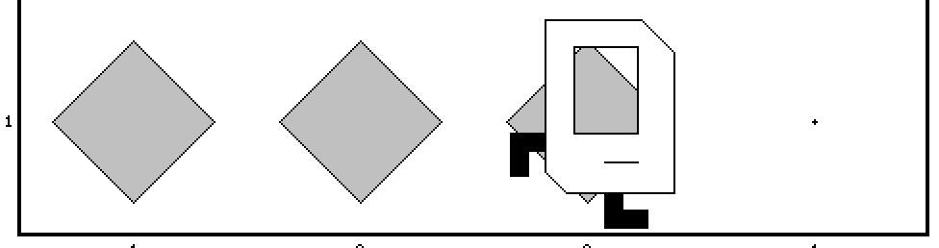
Place Beeper Line
import stanford.karel.*;
public class BeeperLine extends SuperKarel {
public void run() {
// example while loop
while(frontIsClear()) {
putBeeper();
move();
}
// extra put beeper
putBeeper();
}
}

Slide 33
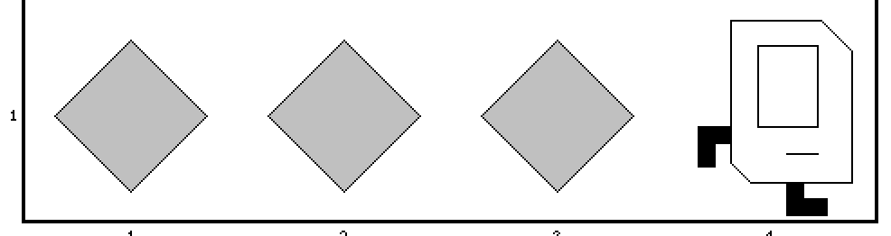
Place Beeper Line
import stanford.karel.*;
public class BeeperLine extends SuperKarel {
public void run() {
// example while loop
while(frontIsClear()) {
putBeeper();
move();
}
// extra put beeper
putBeeper();
}
}

Slide 34
Place Beeper Line
import stanford.karel.*;
public class BeeperLine extends SuperKarel {
public void run() {
// example while loop
while(frontIsClear()) {
putBeeper();
move();
}
// extra put beeper
putBeeper();
}
}

Slide 35
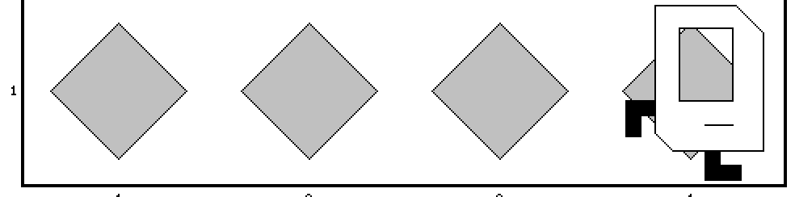
Place Beeper Line
import stanford.karel.*;
public class BeeperLine extends SuperKarel {
public void run() {
// example while loop
while(frontIsClear()) {
putBeeper();
move();
}
// extra put beeper
putBeeper();
}
}

Slide 36


Slide 37
Which Loop
Repeat Process
Know how many times
Don’t know how many times
For Loop
While Loop

Slide 38
What if you only want to repeat one time?

Slide 39
If statement

Slide 40
If Statement
import stanford.karel.*;
public class IfExample extends SuperKarel {
public void run() {
// example of an if statement
if(condition) {
code to run if condition is true
}
}
}

Slide 41
If Statement
import stanford.karel.*;
public class IfExample extends Pretend{
public void run() {
// example of an if statement
if(youLikeBesiktasJK()) {
clapYourHands();
}
}
}

Slide 42
If Statement
import stanford.karel.*;
public class IfExample extends SuperKarel{
public void run() {
safeMove();
}
private void safeMove() {
if(frontIsClear()) {
move();
}
}
}

Slide 43
If / Else Statement
import stanford.karel.*;
public class IfExample extends SuperKarel{
public void run() {
invertBeeper();
}
private void invertBeeper() {
if(beeperPresent()) {
pickBeeper();
} else {
putBeeper();
}
}
}

Slide 44
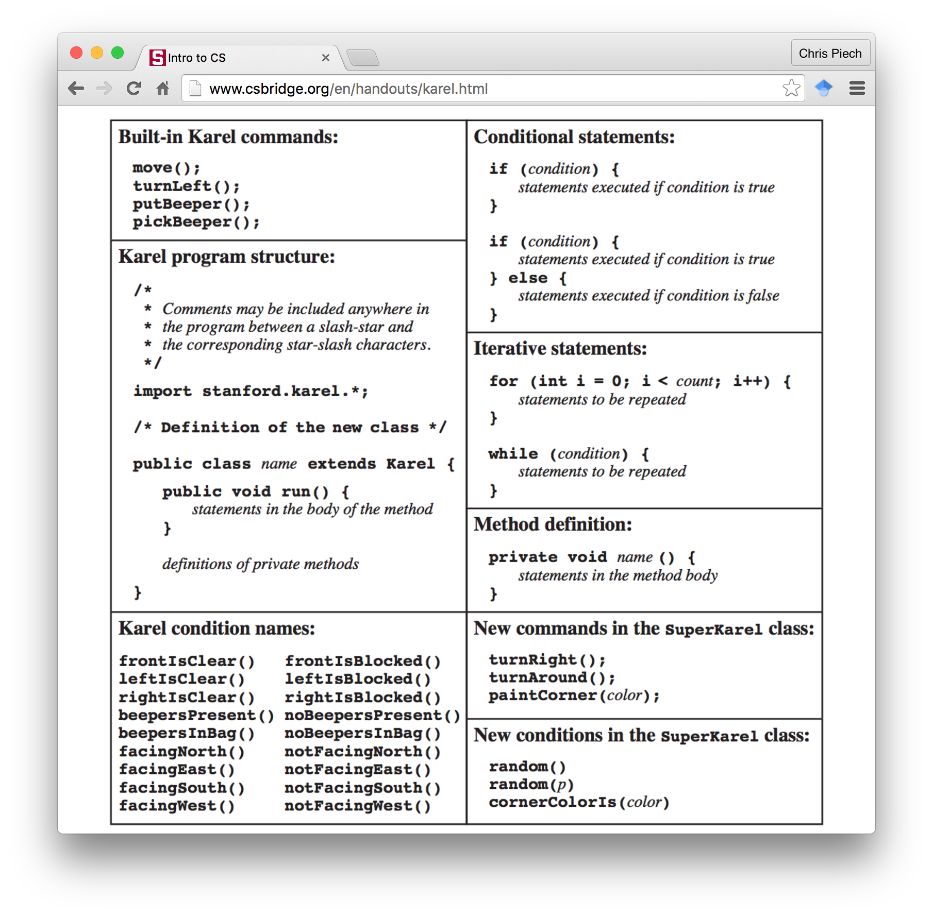
Karel Conditions

Slide 45
Your Tasks

Slide 46
1. Program Build Efes Karel

Slide 47
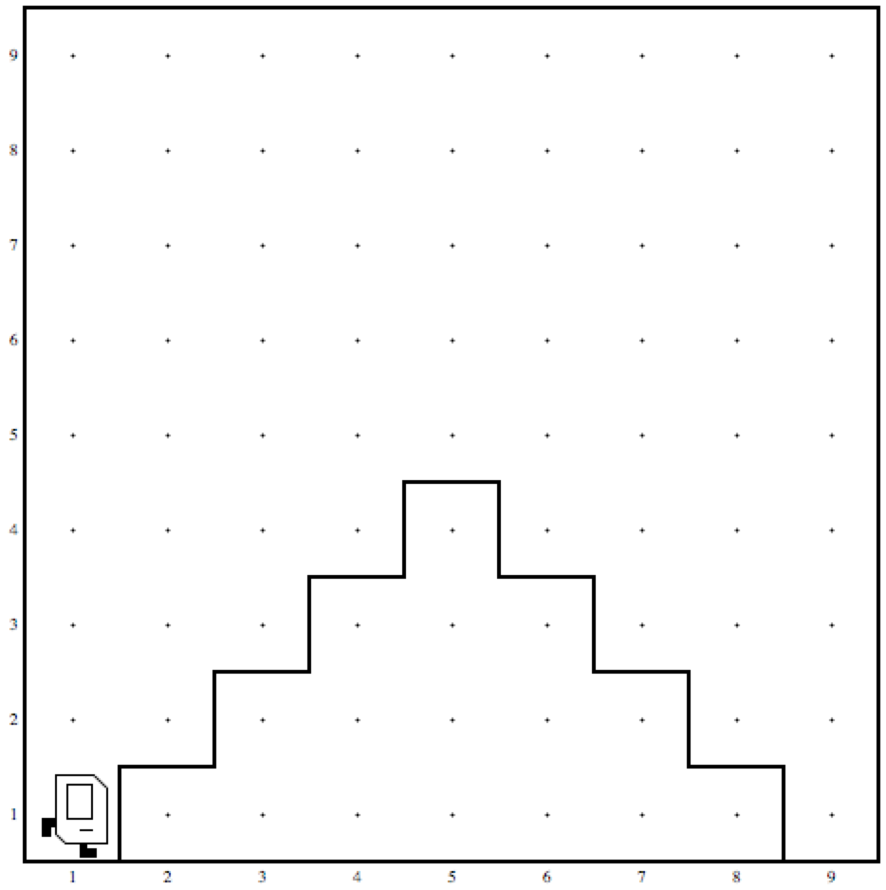
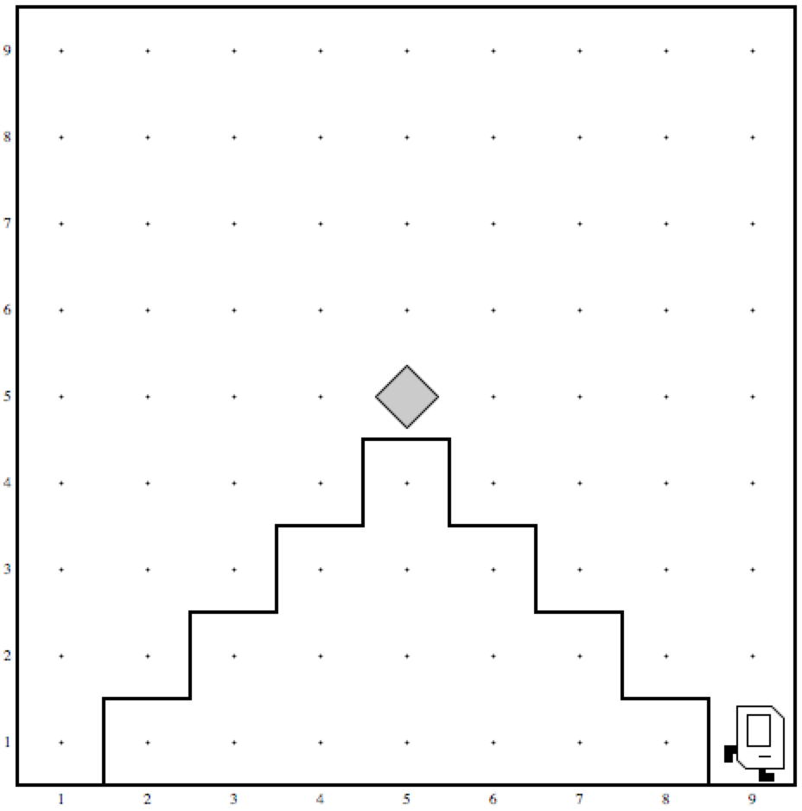
2. Mountain Karel
Before
After

Slide 48
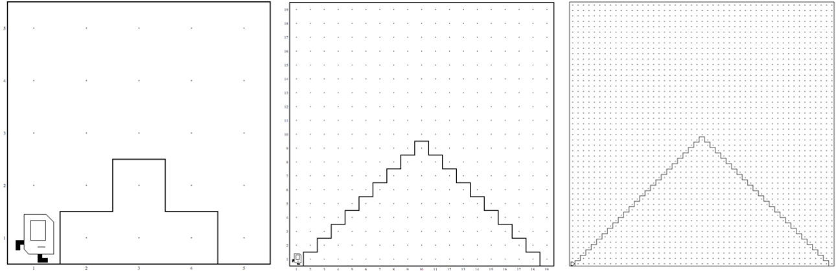
2. Mountain Karel
Should work on a world
of any size ☺

Slide 49
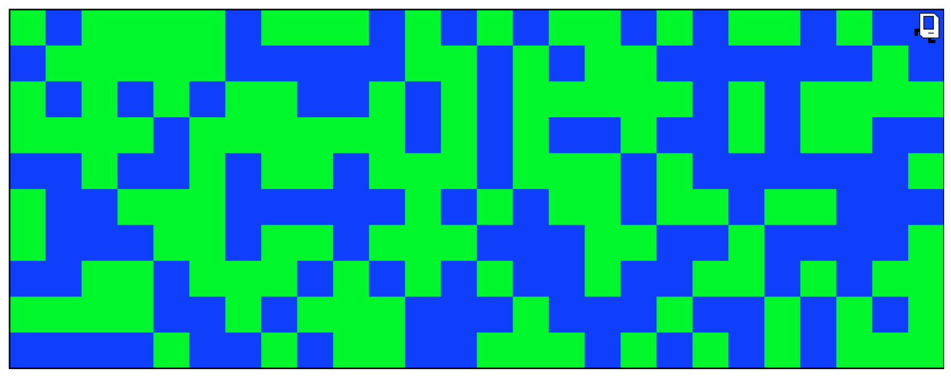
3. Random Painter

Slide 50
What if I finish early?

Slide 51


